Slide 1
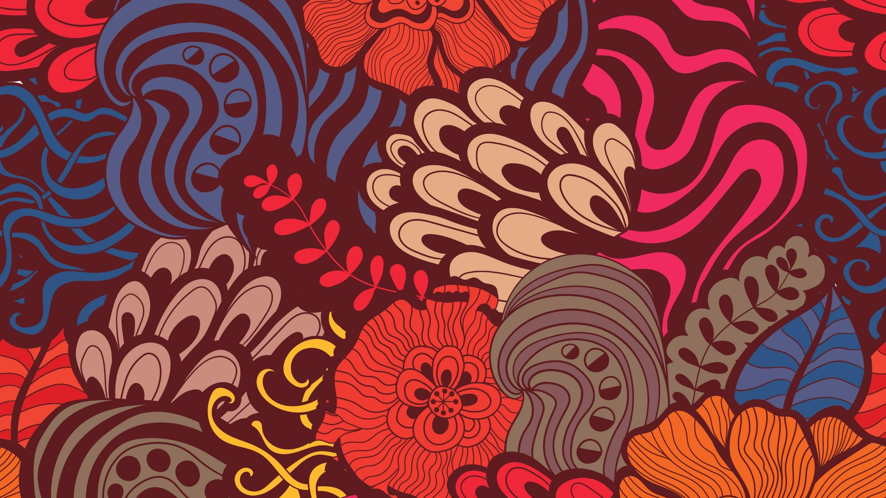
Outreach 2021
Sackville Festival of Early Music

Slide 2
Listening to Early music
Sackville Festival of Early Music
Outreach 2021

Slide 3
Questions to Ask Yourself
Think about a song that you love. What elements of the music in that song stand out to you?
What do you expect early music to sound like?
What technology and performance spaces were available when this music was being written?

Slide 4
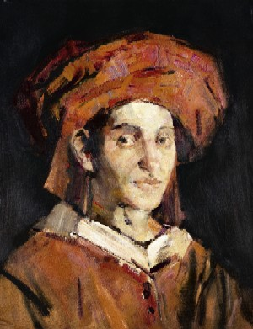
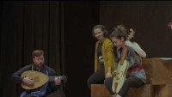
Listen!
Josquin des Prez’s “De tous biens plaine a 3”
https://youtu.be/N4Bqvas8qcc
Josquin des Pres ( c.1450 – 1521)

Slide 5
Early Music Instruments
Sackville Festival of Early Music
Outreach 2021

Slide 6
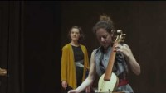
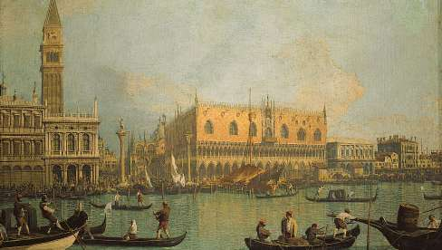
Listen!
Recercare by Marco Dall’Aquila
https://www.youtube.com/watch?v=Kx08Aheyb64
Venice during the 15th C when Marco Dall’Aquila worked there
The Doges' Palace and Piazza San Marco, Venice, oil on canvas by Canaletto

Slide 7
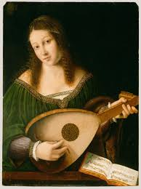
Recercare by Marco Dall’Aquila
Do you recognize any instruments being played?
Do any of the instruments look or sound like instruments you are familiar with? If so, how?
What do all these instruments have in common? What is this family of instruments called?
Woman Playing a Lute by Bartolomeo da Veneto

Slide 8
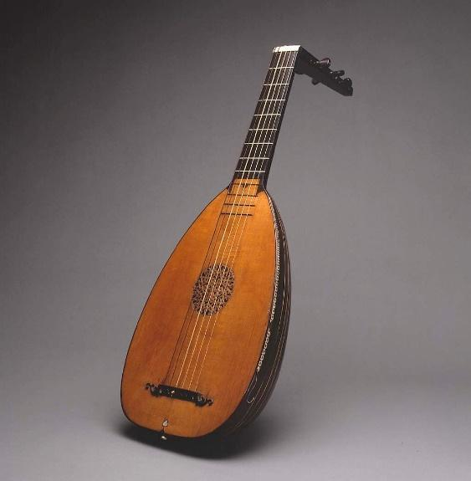
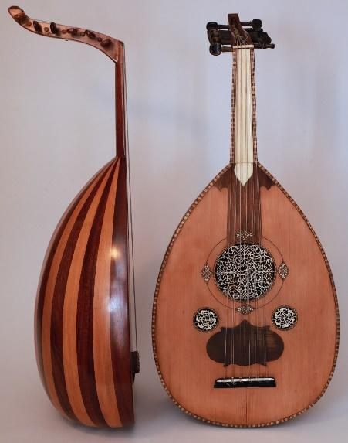
Lute
Lute
Played by plucking the strings
It has a hollow body, like a guitar, with a sound hole that allows the vibrations from the strings to resonate
inside the instrument and produce sound.
Top of the lute has tuning pegs to allow the player to tune the instrument
Lutes are similar to the Arab ‘ud which can be traced back to the sixth century!
‘Ud

Slide 9
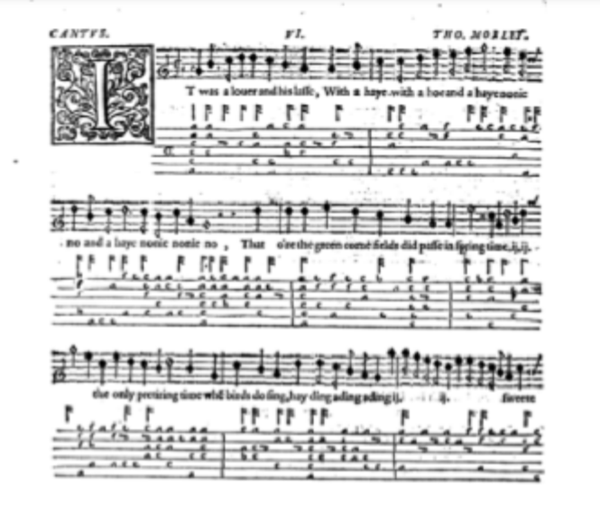
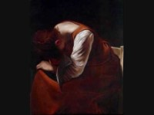
Lute Tablature
The lute tablature tells players which fret on each string to hold down to play the desired notes.
Activity: Listen to lute tablature in action here with Dowland’s “Sorrow Stay” sung by Andreas Scholl:
"It Was a Lover and his Lass" by Thomas Morley in First Book of Songs and Ayres
https://youtu.be/smH1rIZyea4

Slide 10
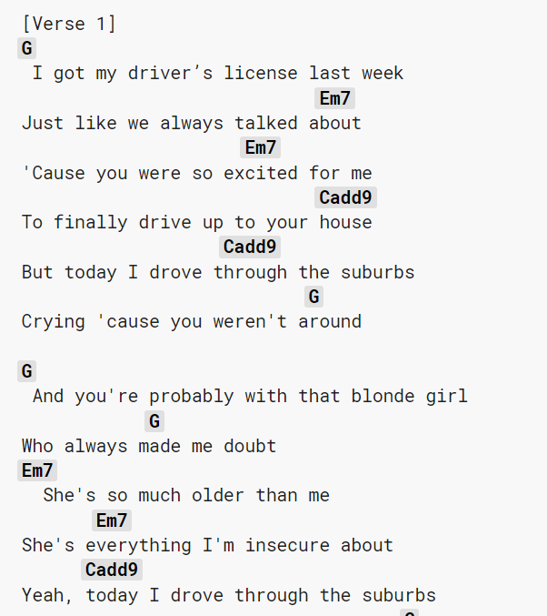
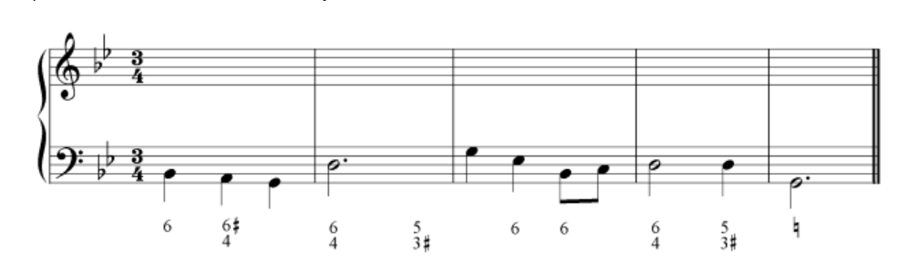
A Note on Notation
Present-day guitar players might read chord symbols like these
Lute players can also look at figured bass and do the same thing.

Slide 11
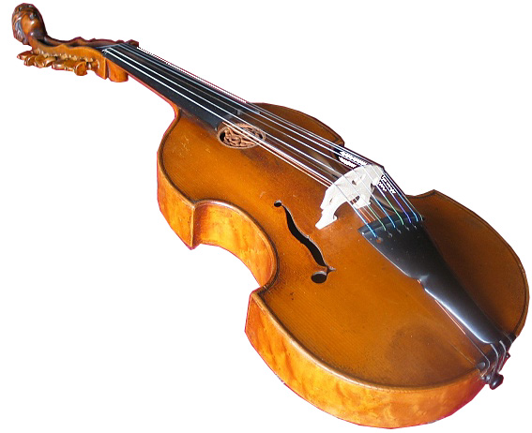
Viola d’Arco
Bowed instrument played by moving a horsehair bow across the instrument’s strings, making the strings vibrate and create sound.
The instrument is held between the player’s legs, like a cello.
The viola d’arco dates back to the Medieval era and is an ancestor of the viola da gamba.

Slide 12
Music and Dance
Sackville Festival of Early Music
Outreach 2021

Slide 13
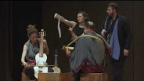
Listen & Watch
Al Alba venir and De mon triste displasir
https://youtu.be/2ds9QT4Iu90

Slide 14
Questions
Did you like the fusion of dance and music? Why or why not?
Where else do you see music and dance together?
How did the music and dance reflect each other?
Notice the movements the musicians make: do you think this is dance? Can we consider the dance solo at the end of this video clip to be music?

Slide 15
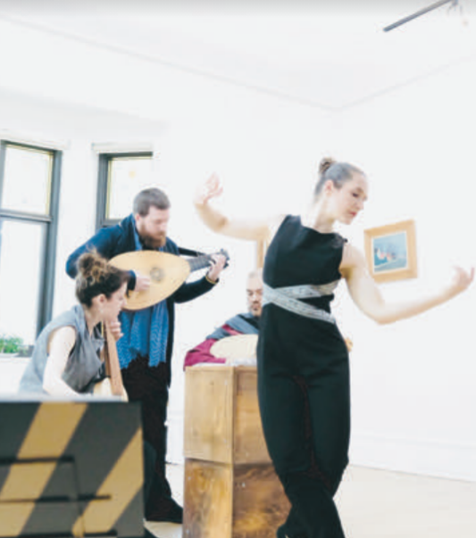
Dance and Music
Early dance refers to dance that was popular during the Renaissance and Baroque periods
Based on stylized or dramatized versions of everyday movements such as walking, running, jumping, sliding, turning, or falling.
Early dance is like early music in that it emphasizes tension and release.
Dancers emphasize strong beats by rising up on their toes.
Before the strong beat the dancer often bends to further emphasize the rise on the strong beat.

Slide 16
Dance and Music
14th century artists, poets, and philosophers developed an interest in Ancient Greece and Rome that would continue
Dance which became a huge part of daily life
Much of the earliest European dance music was either vocal music rearranged for a group of instruments or an improvisation.
Composers later began writing purely instrumental
dance music.
Goal was to musically reflect the dancers’ movements which led to the development of many new musical forms, such as the pavane.

Slide 17
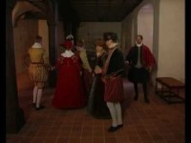
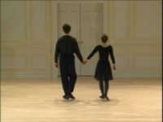
Pavane
A pavane is a stately dance in 2/2 or 4/4 done in pairs. The movements are simple and consist of a pattern of forward and backward steps. Give it a try!
Watch a simple pavane here to help you out
https://youtu.be/B10z9b_PRXw
Watch the pavane here
https://youtu.be/hVBlFUb0g60

Slide 18
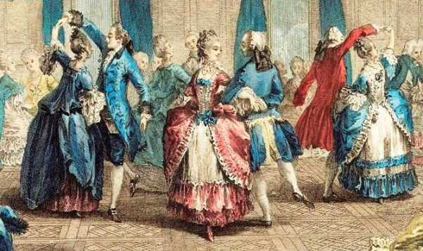
Pavane
Line up in pairs (only if distancing allows; a single line works as well!)
2. Take one step forward with your left foot then bring your right foot to touch the ground beside the left foot.
3. Take another step forward this time with your right foot and bring the left foot to rest beside the right.
4. Take three steps forward starting on your left foot.
5. Repeat steps 2–4.
6. Repeat in reverse! One step back with your left foot, one step back with your right foot, and then three steps back: left, right, left.
7. Try it out with the pavane recording!
https://youtu.be/B10z9b_PRXw
Music for your pavane here:
https://youtu.be/B10z9b_PRXw

