Slide 1
6 - Le Badinage
Sackville Festival of Early Music
Educational Outreach 2020

Slide 2
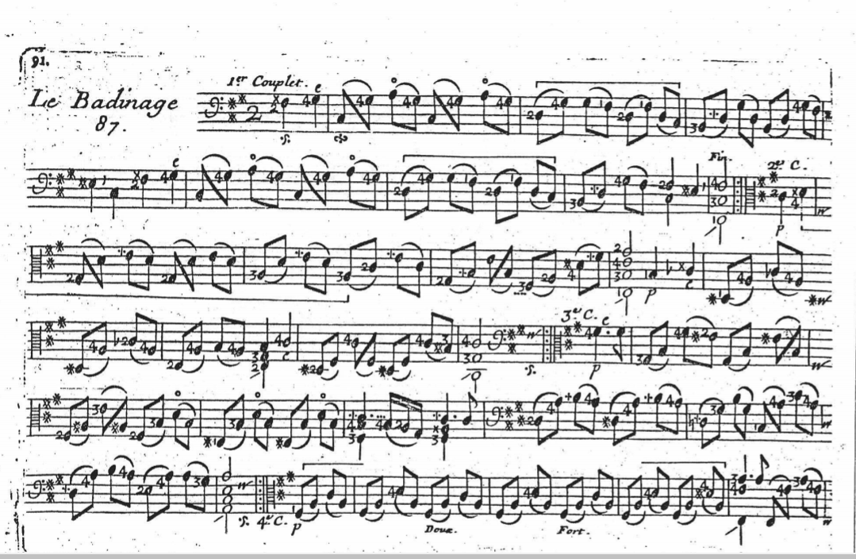
Rondeau Form
French baroque music contains tiny figures notated above the musical notes, telling performers when to perform ornamentation. Numbers alongside or below the notes tell the player which added notes or fingerings to play. This level of control in French music is mirrored in French dances for the King.
Le badinage
By Marin Marais

Slide 3
Rondeau Form
CHORUS
We can write this same pattern with letters
Each part is labeled with a letter. The parts that sound the same are given the same letter.
The choruses (refrains) are all the same and the piece starts with a chorus so we call them A
The next part of the piece sounds different and comes after A so we call it B. The second part is C and so on
The form written out is : ABACA
VERSE
CHORUS
VERSE
CHORUS

Slide 4
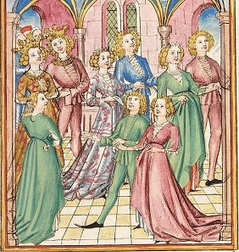
Rondeau Form
One of three forms that dominated the 14th and 15th centuries
Developed as dance music in the 13th century
The word is derived from Latin and means round
This refers to the motions of the dance and the repetitive nature of the music

Slide 5
Le badinage
Go listen to Le badinage and try to count the verses!

Slide 6
Le badinage
Try to count how many verses there are!

Slide 7
Le badinage

Slide 8
Rondeau Form
Most pop songs follow a similar form, with verses and chorus
Some have an extra part that doesn’t sound like a verse or a chorus; this is called a bridge
Think of a song that uses this form!

Slide 9
Credits
Sackville Festival of Early Music
Dr. Linda Pearse, Artistic Director and Associate Professor, Mount Allison University
Shawn Bostick, Administrative Director
Paula Stewart, Educational Advisor and Board Director
Annika Williams, J.E.A. Crake Intern
Contact Us
www.sackvilleearlymusic.com
506.878.3786
Twitter/Instagram: @sfearlym
https://www.facebook.com/SackvilleFestivalofEarlyMusic/
Thank you to our funders: Heritage Canada, the Province of New Brunswick, the Town of Sackville,
the J.E.A. Crake Foundation, the Rotary Club of Sackville, Mount Allison University, and the generous donors in our community.

